Slide 1
Generative Adversarial Network (GAN)
Goodfellow et al, “Generative Adversarial Networks”, NIPS 2014

Slide 2
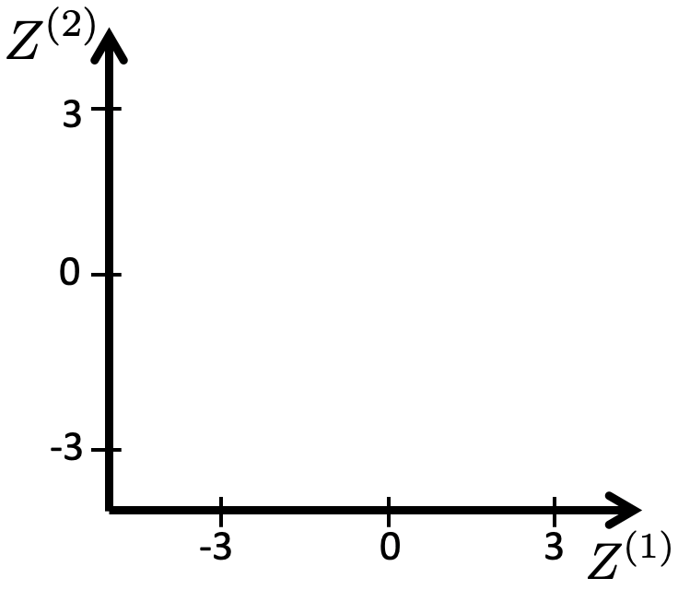
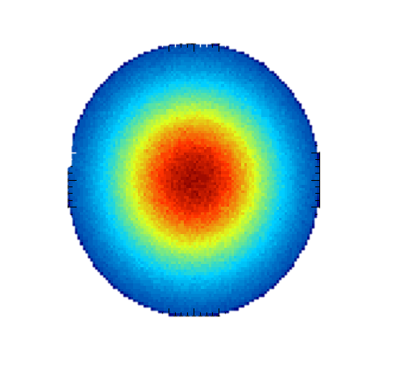
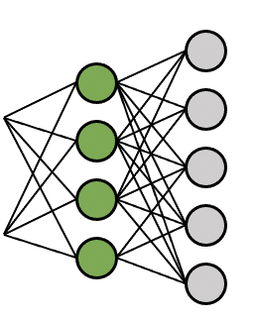

What is a Generative Model?
“A generative model describes how a dataset is generated, in terms of a probabilistic model.
By sampling from this model, we are able to generate new data.”
Generative Deep Learning, by David Foster
Prior distribution of z
Generative models:
Sampling
Generated new data point
We assume: z “causes” x
z “causes” x
z: content, lighting, zoom … x: the photo

Slide 3
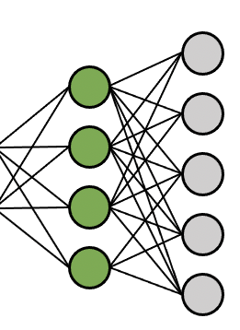
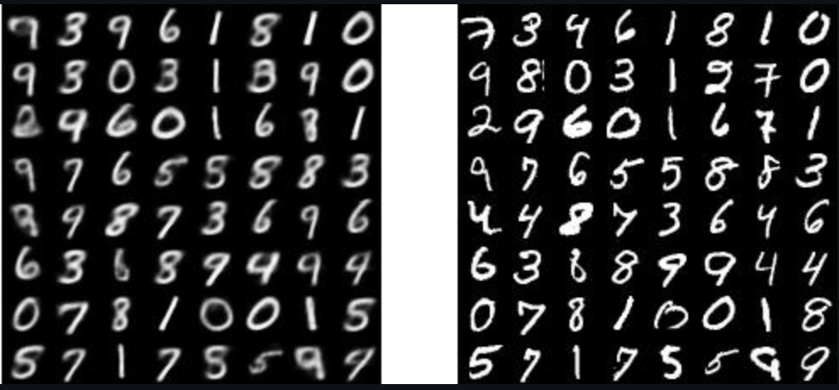

VAEs: Training
Predicted distributions p(z|x) of all training
sample
“prior” distribution of z,

Slide 4
VAEs: Generating after sampling from a prior p(z)
“prior” distribution of z,
sample

Slide 5
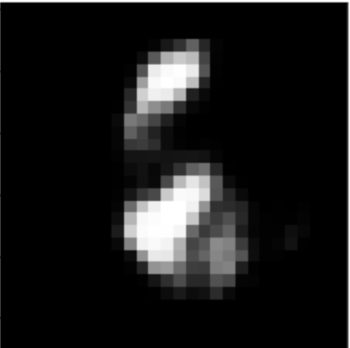
Generative Adversarial Network
“prior” distribution of z,
Generator
Sample
Can be multi-dimensional

Slide 6
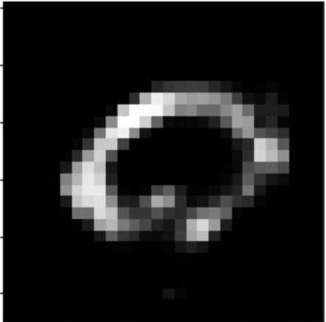
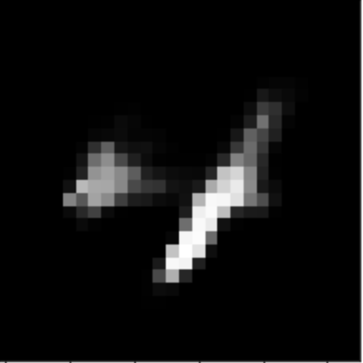
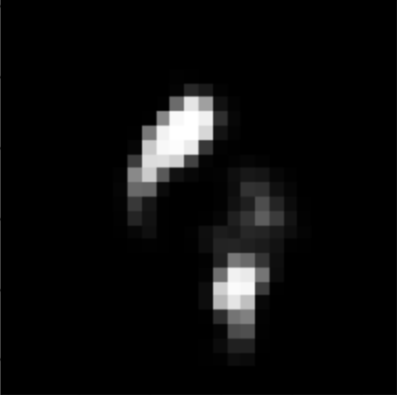
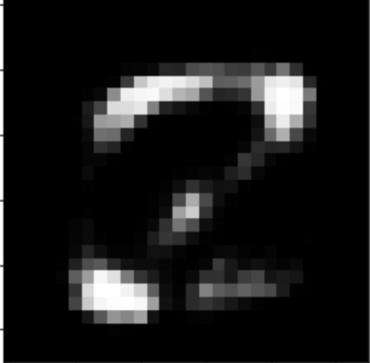
Generative Adversarial Network
Generated data are samples from the *model’s* probability density function of x
“prior” distribution of z,
Generator
Sample

Slide 7
Generative Adversarial Network
Generated data are samples from the *model’s* probability density function of x
“prior” distribution of z,
Generator
Sample
Training data are samples from the *real* probability density function of x
Real data (training database)

Slide 8
How can we learn ? (Density estimation)
Generated data are samples from the *model’s* probability density function of x
“prior” distribution of z,
Generator
Sample
Training data are samples from the *real* probability density function of x
Real data (training database)

Slide 9
How can we learn ? (Density estimation)
“prior” distribution of z,
Generator
Sample
Discriminator
Is input Real or Fake?
G could change its parameters to make fake data that D cannot differentiate from real data!
If fake and real data differ, D could learn to classify them!
Real data (training database)

Slide 10
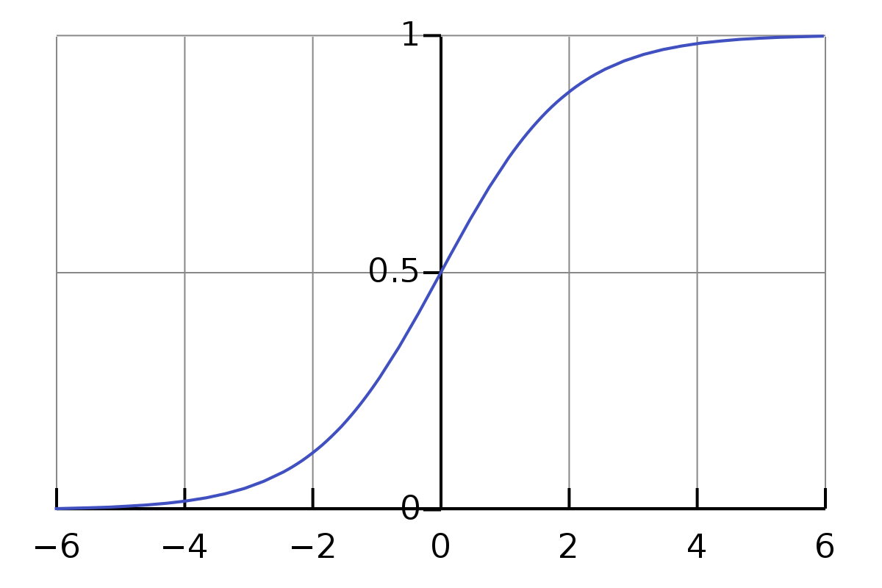
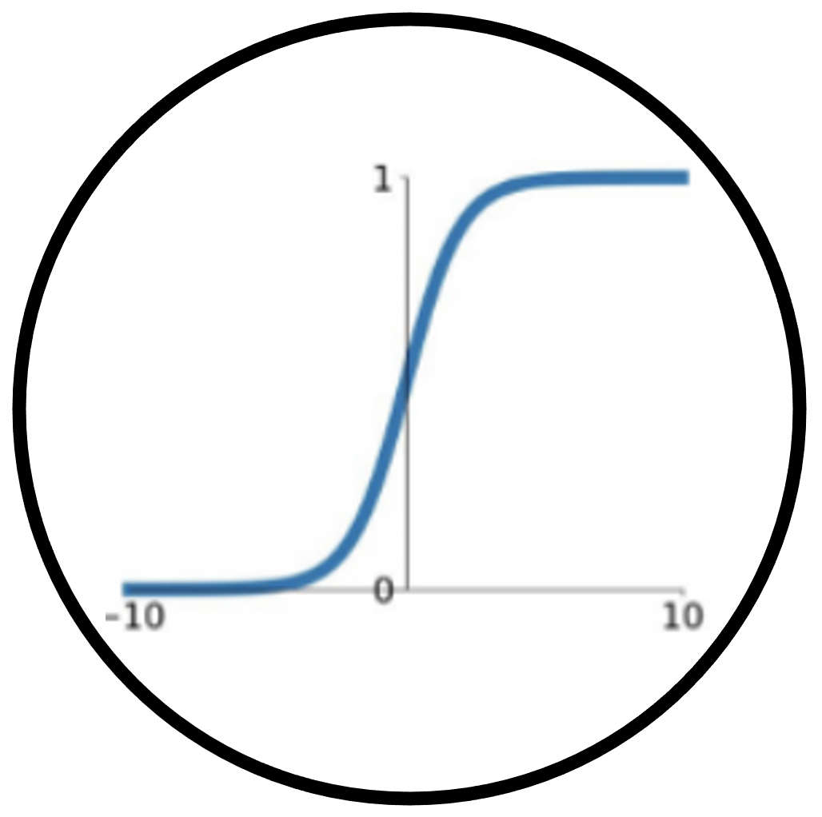
The Discriminator - Binary Classifier of inputs: Real or Fake?
Sigmoid activation function
Discriminator
(binary classifier)
Is input Real or Fake?

Slide 11
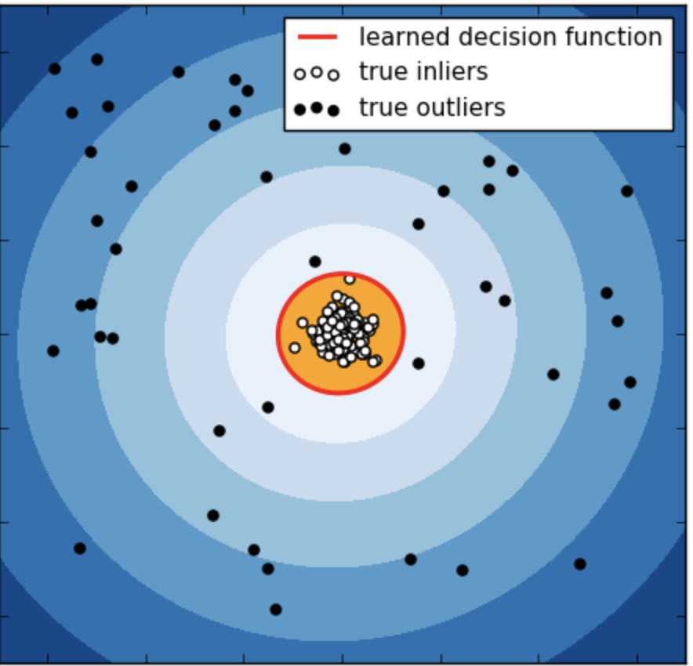
The Discriminator - Binary Classifier of inputs: Real or Fake?
Real data
Fake samples
Image modified from Scipy

Slide 12
The Discriminator - Binary Classifier of inputs: Real or Fake?
Sigmoid activation function
Discriminator
(binary classifier)
Is input Real or Fake?
Discriminator learns a decision boundary between real and fake samples.
For each input, it predicts the probability that the input is real or fake.

Slide 13
The Discriminator - Binary Classifier of inputs: Real or Fake?
Generator
Discriminator
(binary classifier)
“prior”
Sample
Is input Real or Fake?

Slide 14
The Discriminator - Binary Classifier of inputs: Real or Fake?
Generator
Discriminator
(binary classifier)
“prior”
Sample
Is input Real or Fake?

Slide 15
The Discriminator - Binary Classifier of inputs: Real or Fake?
Generator
Discriminator
(binary classifier)
“prior”
Sample
Is input Real or Fake?
Can be understood as if D learns by minimizing 2 losses:
- One for real samples (make D(x) go to 1)
- One for fake samples (make D(G(z)) go to 0)

Slide 16
The Discriminator - Binary Classifier of inputs: Real or Fake?
Generator
Discriminator
(binary classifier)
“prior”
gradients
Sample
Is input Real or Fake?
gradients
Can be understood as if D learns by minimizing 2 losses:
- One for real samples (make D(x) go to 1)
- One for fake samples (make D(G(z)) go to 0)
Both losses are functions of D’s parameters
By backpropagation, we can learn optimal D.
Note: All this for “fixed” G parameters.

Slide 17
The Discriminator - Binary Classifier of inputs: Real or Fake?
Generator
Discriminator
(binary classifier)
“prior”
gradients
Sample
Is input Real or Fake?
gradients
In practice, SGD with 2 batches: batch of (N_{D,r}) real data and batch of (N_{D,f}) fake samples:

Slide 18
The Discriminator - Binary Classifier of inputs: Real or Fake?
Generator
Discriminator
(binary classifier)
gradients
“prior”
Sample
Is input Real or Fake?
Note-1: The term over fake samples is also a function of the Generator parameters
Note-2: The generated output G(z) is “just” another activation map, on top of which we connect the Discriminator.
Therefore, we can backpropagate through the generated output G(z). We can use this to alter parameters of G to change this term in the opposite direction and confuse the Discriminator!

Slide 19
Adversarial Training
Generator
Discriminator
(binary classifier)
“prior”
Sample
Is input Real or Fake?
Objective function of the Min-Max game
Two-player Min-Max game for optimization (from Game Theory):
For given (fixed) G, D tries to maximize D’s accuracy of separating Reals from Fakes
For given (fixed) D, G tries to minimize D’s accuracy of separating Reals from Fakes
Therefore called “adversarial”.

Slide 20
Adversarial Training: Loss of G
Generator
Discriminator
(binary classifier)
“prior”
Sample
Is input Real or Fake?
For fixed Discriminator parameters , we train Generator parameters :
Function of
Loss (theoretical) of Generator
In practice, SGD with a batch of fake samples (size N_{G}):

Slide 21
Training GANs Algorithm (Theoretical L_{G})
Opposites

Slide 22
How does adversarial training achieve ?
Objective function of the min-max game
It has been proven that if we assume D has infinite capacity (can learn anything), then for given (G params), optimal D is:
Proof: Goodfellow et al, “Generative Adversarial Nets”, 2014, sec 4.1.
Then, by substituting to the GAN’s total objective function we have:
Jensen-Shannon divergence between

Slide 23
How does adversarial training achieve ?
The previous theoretical results means:
*If* D was perfectly optimized at every SGD iteration before updating G,
then minimizing with *would* lead to minimization of JS divergence.
This in turn means the generator *would* replicate learn the density of real data “perfectly”,
i.e.
But, in practice:
a) we don’t optimize D perfectly in each SGD iteration (only K updates, and SGD local minima), b) we often use another loss for G, rather than what we showed before (which was aligned with theory)…
Regardless, this theoretical result gives a nice intuition about how GANs work.

Slide 24
Training GANs Algorithm (Theoretical L_{G})
Opposites

Slide 25
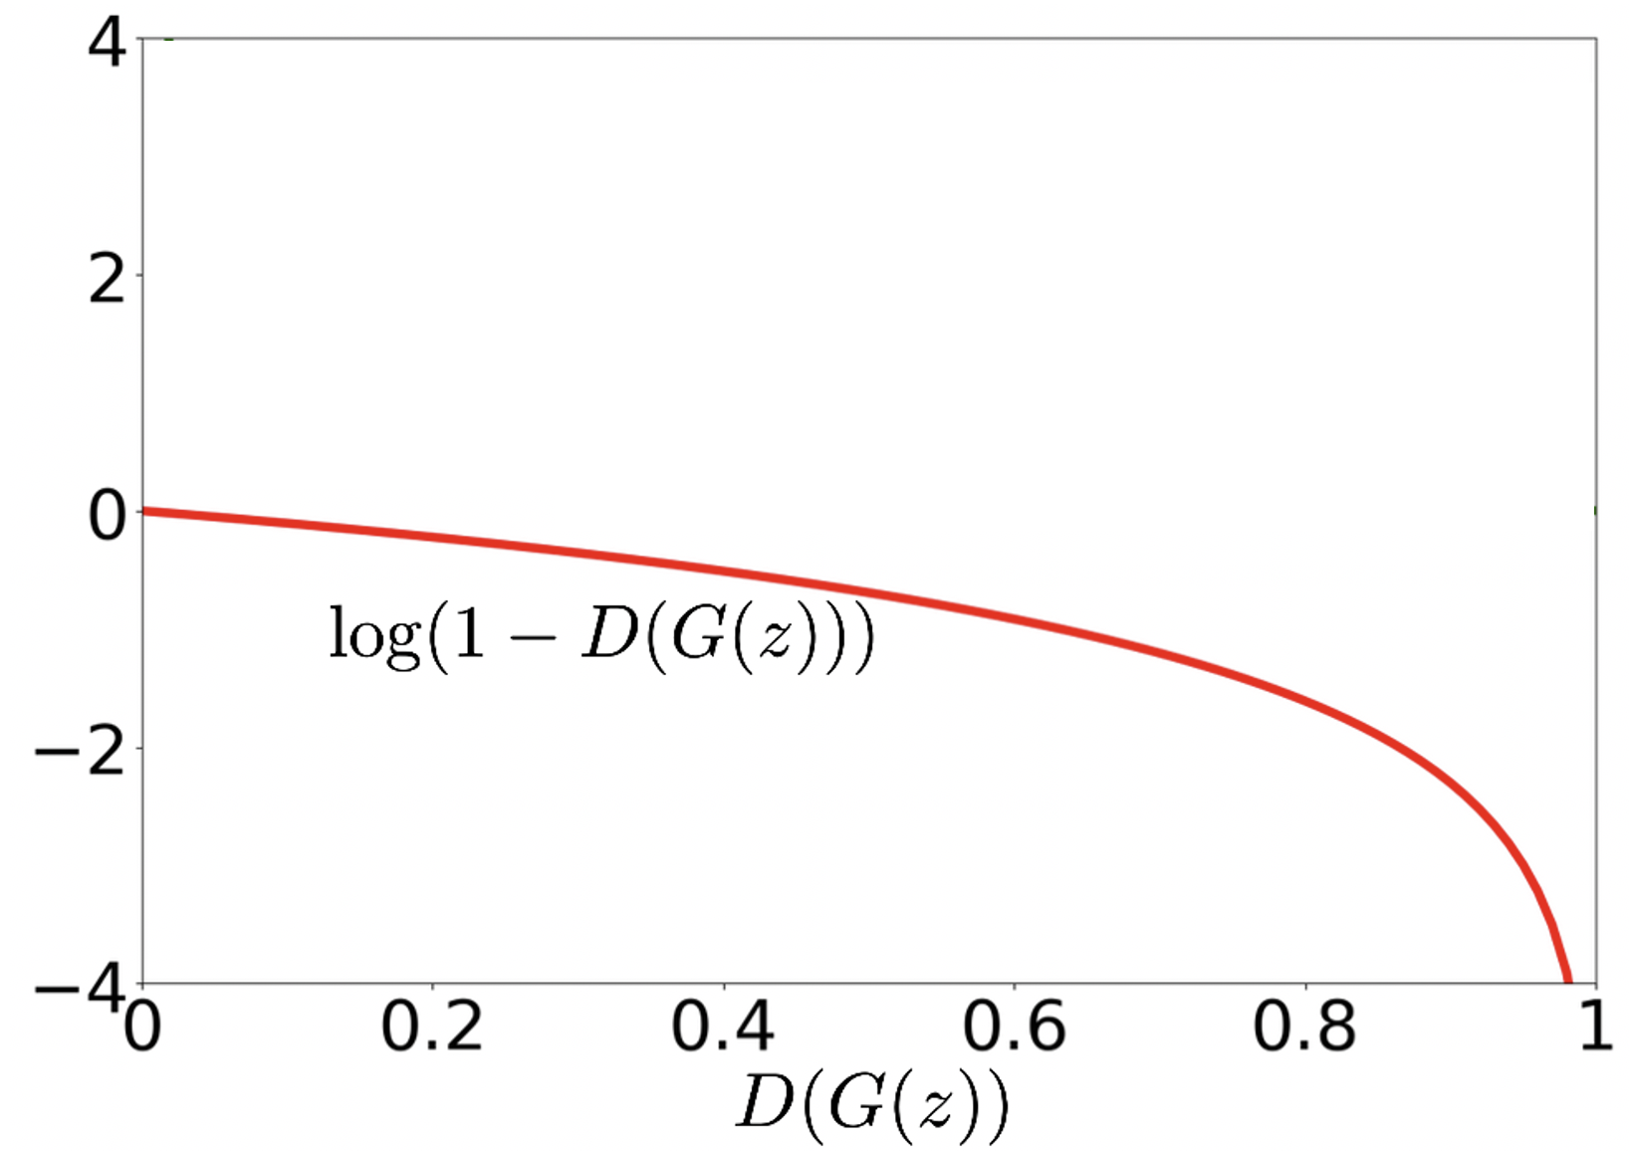
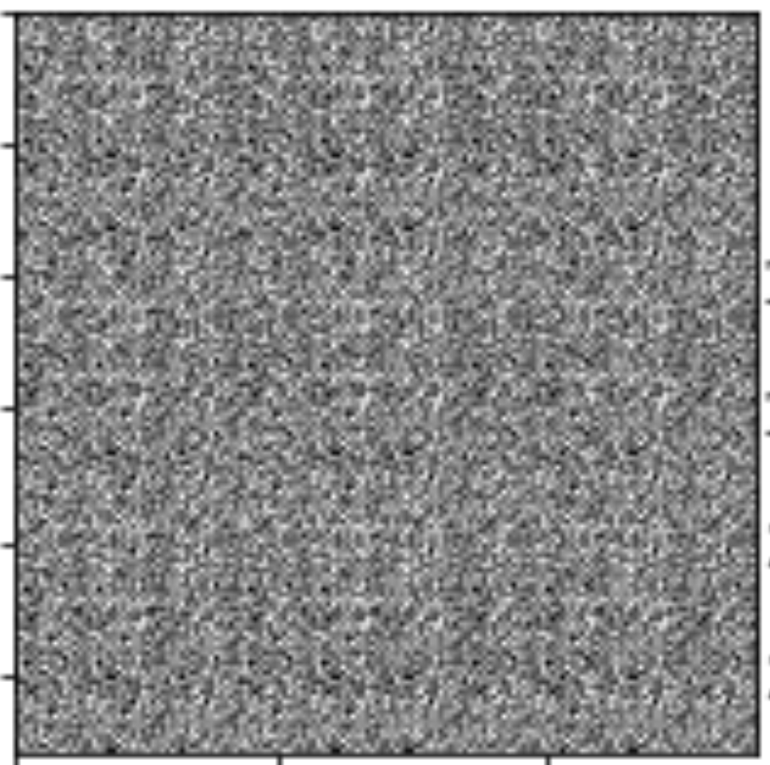
Losses for training the Generator G
Loss value
Training starts here, because untrained G(z) generates very bad output
Even for great samples G(z), grads large!
Here it should be saturating, to let model learn from bad samples, to improve them.
Theoretically motivated loss
D is certain that input G(z) is Fake (correctly)
D is certain that input G(z) is Real (it got tricked by G)

Slide 26
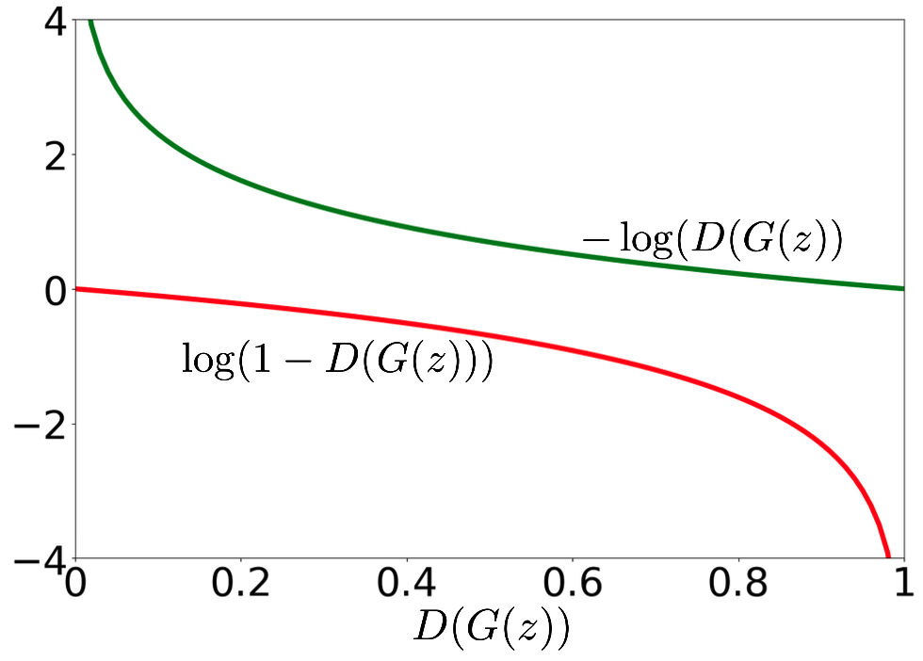
Losses for training the Generator G
Commonly used in practice
Loss value
Theoretically motivated loss
D is certain that input G(z) is Fake (correctly)
D is certain that input G(z) is Real (it got tricked by G)

Slide 27
Losses of G: are they comparable?
Theoretically motivated loss for G (min max game minimizing JS divergence):
Minimize the log
Minimize (because log convex)
Maximize
Practical loss for G:
They both try to maximize the probability that D will think fake samples are real. But using different gradients to get there.
Minimize the -log
Maximize the log
Maximize

Slide 28
Training GANs Algorithm (Practical L_{G})
“Practical” version of Generator’s loss.

Slide 29
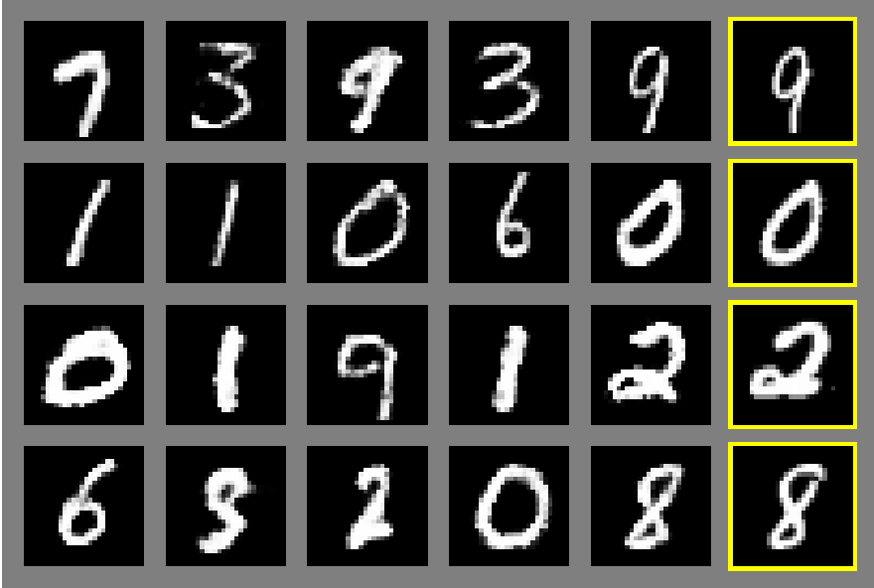
After training: G maps any point of z from prior p(z) to a “realistic” x=G(z), where all G(z) form
Generator
“prior” distribution of z,
Sample
To generate new data from a GAN: Step 1. sample z from prior N(0,I)
Step 2. “Decode” using G, obtaining G(z), the generated sample.
The process is “exactly” the same as if generating using prior and decoder of a trained VAE.
(Note: Discriminator is not used for generation)

Slide 30
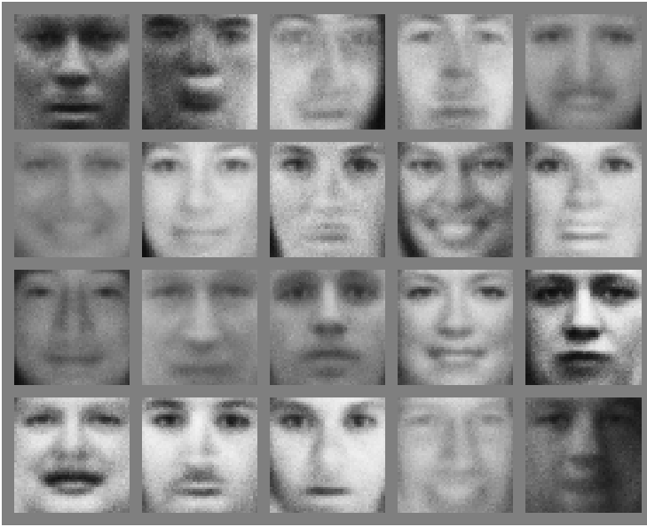
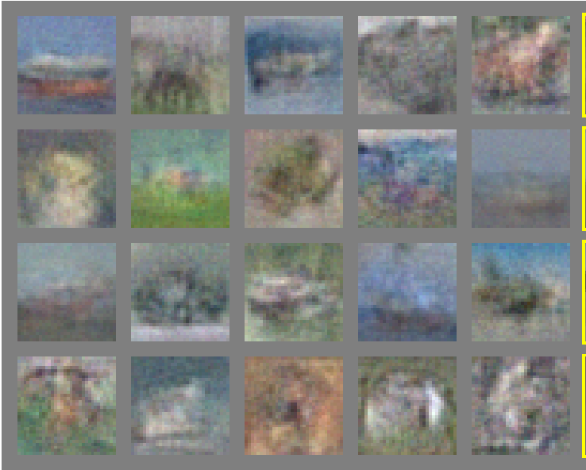
Generated samples from a basic GAN - 2014
MNIST
TFD
CIFAR-10
From: Goodfellow et al, ”Generative Adversarial Nets”, 2014

Slide 31
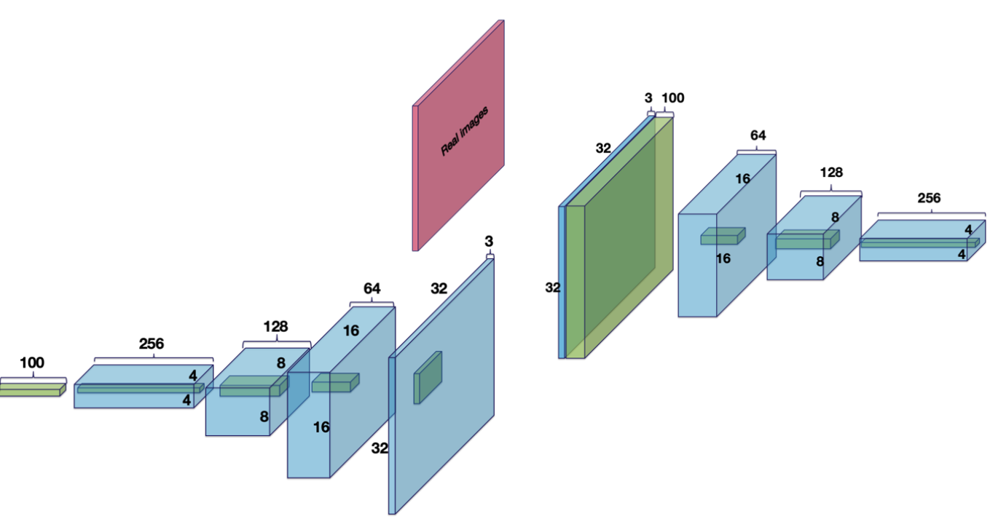
Deep Convolutional GAN (DCGAN) - 2016
Radford et al, Unsupervised Representation Learning with Deep Convolutional Generative Adversarial Networks, ICLR 2016
Discriminator
100-d prior
Generator
Image modified from Satrfall6 (link)

Slide 32
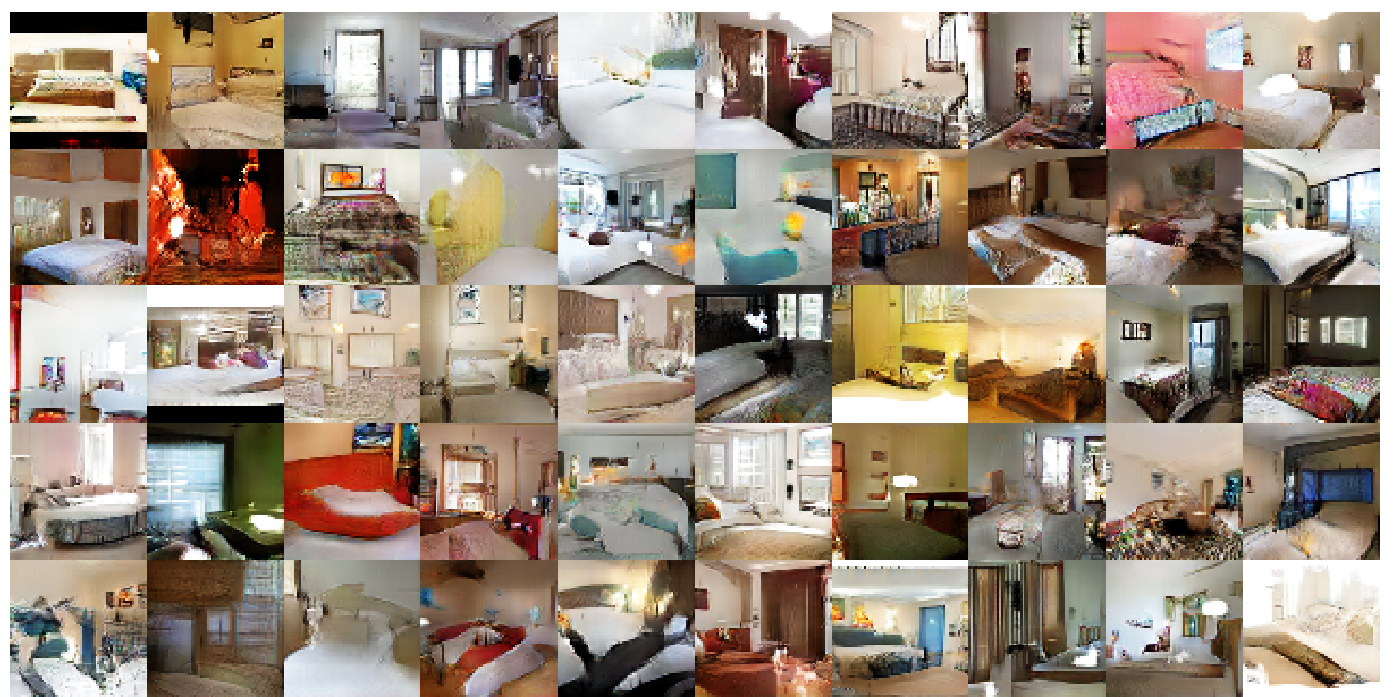
Deep Convolutional GAN (DCGAN) - 2016
Radford et al, Unsupervised Representation Learning with Deep Convolutional Generative Adversarial Networks, ICLR 2016

Slide 33
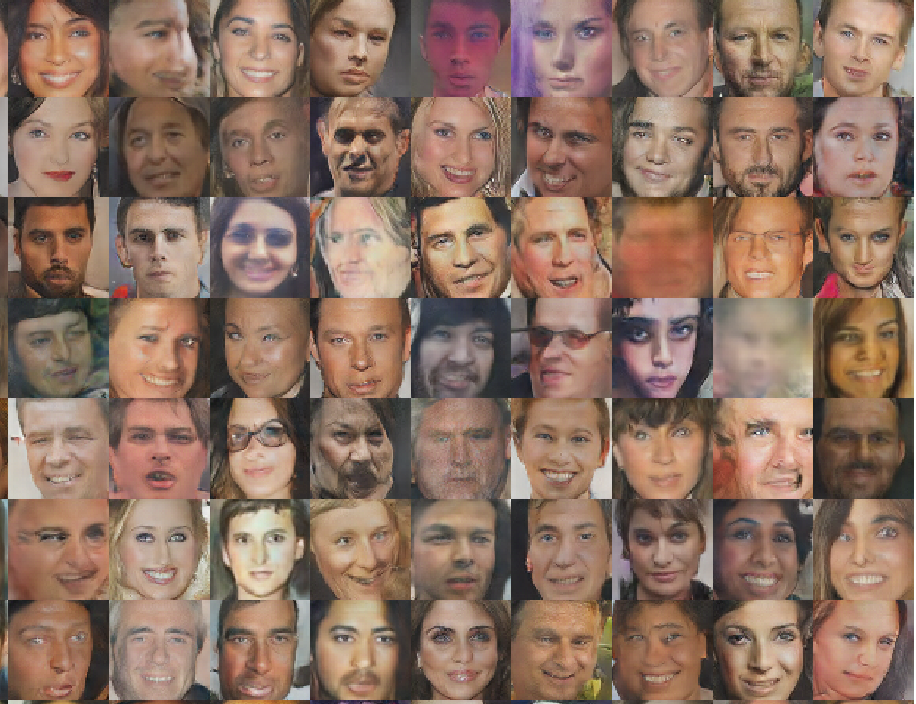
Deep Convolutional GAN (DCGAN) - 2016
Radford et al, Unsupervised Representation Learning with Deep Convolutional Generative Adversarial Networks, ICLR 2016

Slide 34
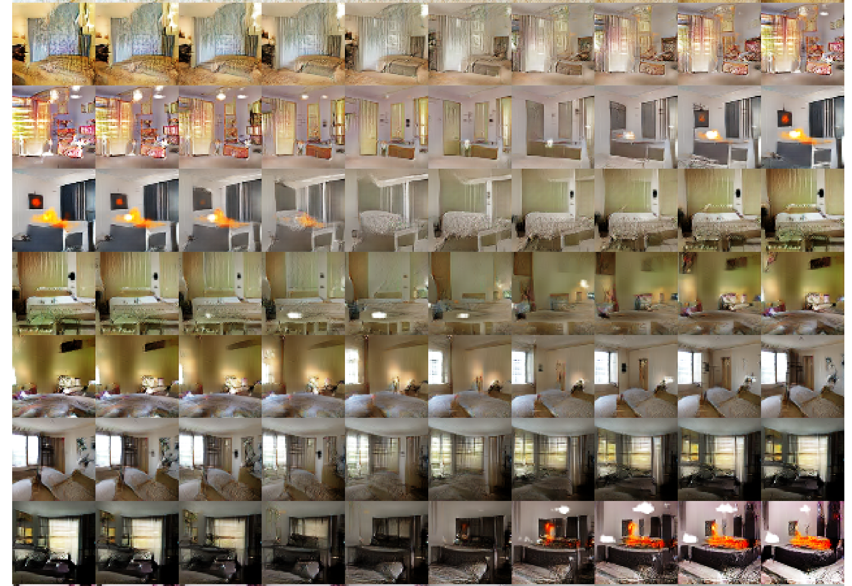
DCGAN: Interpolation by decoding z between 2 values
Radford et al, Unsupervised Representation Learning with Deep Convolutional Generative Adversarial Networks, ICLR 2016
z₁, z₂ are different (randomly sampled) per row
Observe that results change ”smoothly” (similar to VAEs).
There is no theoretical explanation why this happens in GANs (in contrast to VAEs), but it is often empirically observed.

Slide 35
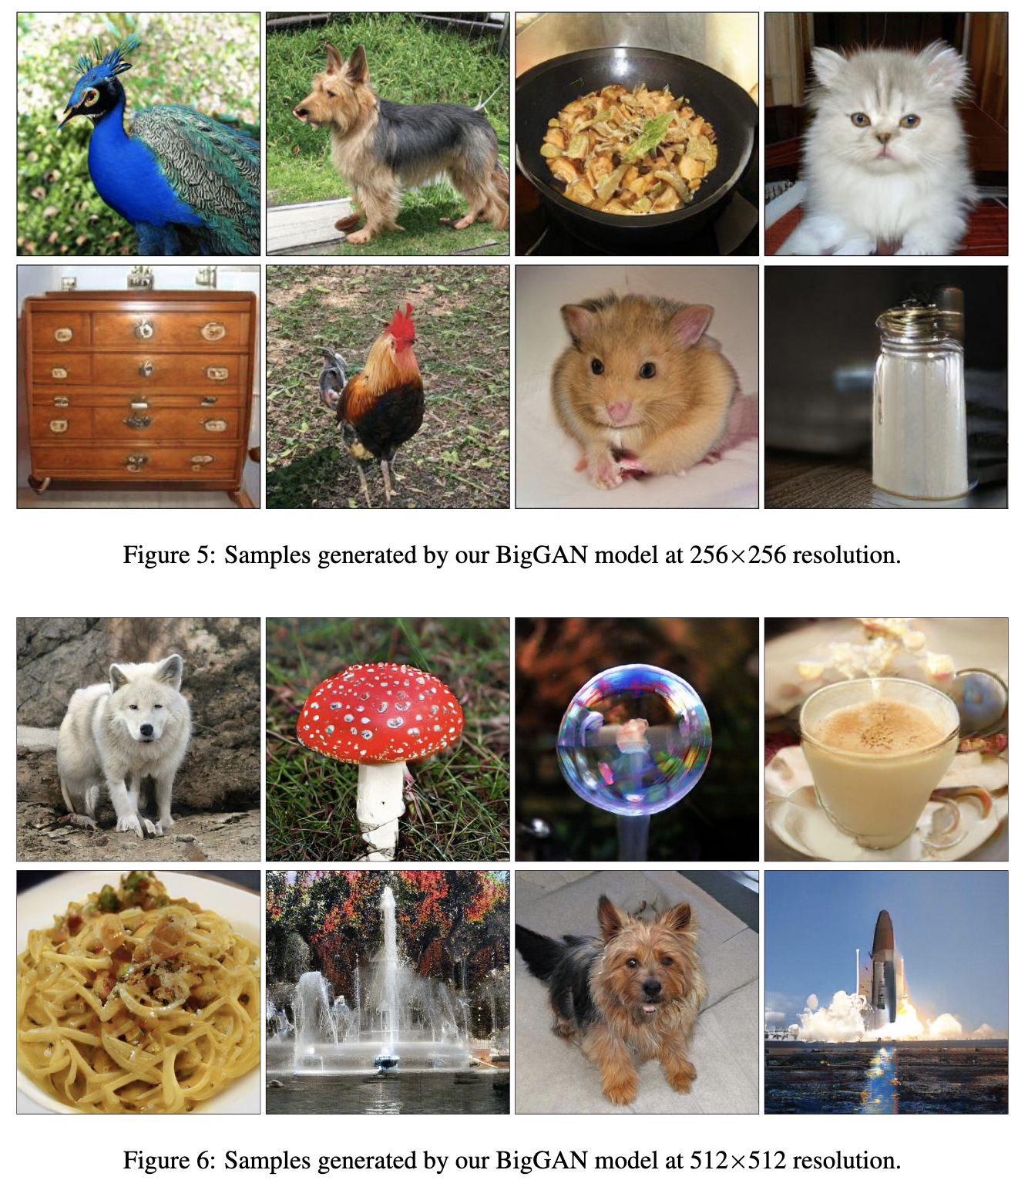
BigGAN - 2019
Brock et al, Large scale GAN training for high fidelity natural image synthesis, 2019

Slide 36
Thank you very much

